Slide 1
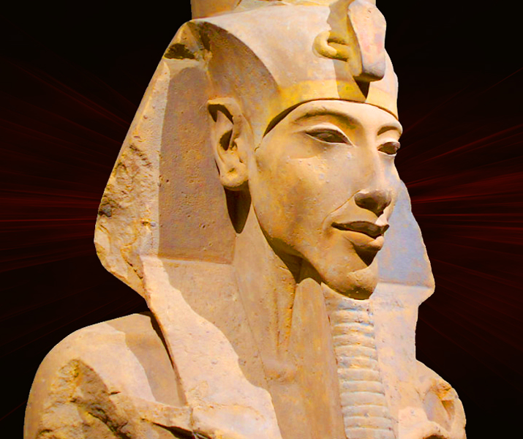
A New Capital City
GOAL/S: Identify the reasons for the new capital city
Explore evidence
Week 1, Lesson 2

Slide 2
Akhenaten, the Pharaoh of ancient Egypt, established a new capital city called Akhetaten (or Amarna) around 1349 - 1346 BCE. This city, located on the east bank of the Nile River, was dedicated exclusively to the worship of the solar deity Aten. Akhenaten’s religious reforms prompted this move, and the city’s construction primarily involved mudbrick buildings. Today, Amarna stands as an extensive archaeological site, preserving the legacy of Akhenaten’s unique reign and religious beliefs.

Slide 3
A new Capital City
WHO:
Pharaoh Akhenaten, who reigned during the late Eighteenth Dynasty of Egypt.
WHAT:
He created a new capital city called Akhetaten (also known as Amarna).
WHEN:
Construction began around Year 5 of his reign (approximately 1349 - 1946 BCE
It was likely completed by Year 9 (around 1341 BCE).
However, it officially became the capital two years earlier.

Slide 4
Overview:
WHERE:
The city was situated on the east bank of the Nile River, in what is now the Egyptian province of Minya.
It lies about 58 km (36 mi) south of al-Minya, 312 km (194 mi) south of Cairo, and 402 km (250 mi) north of Luxor (the previous capital, Thebes).

Slide 5
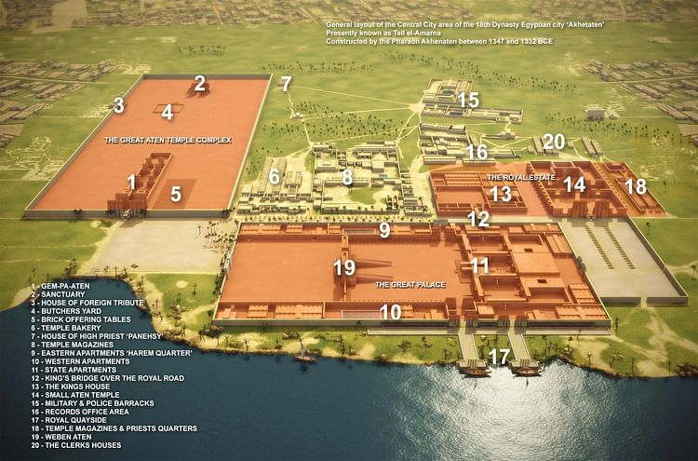
Notes:
Map showing the general layout of the central city area of the 18th Dynasty Egyptian city "Akhetaten", presently known as Tell el-Amarna, constructed by the Pharaoh Akhenaten between 1347 and 1332 BCE.

Slide 6
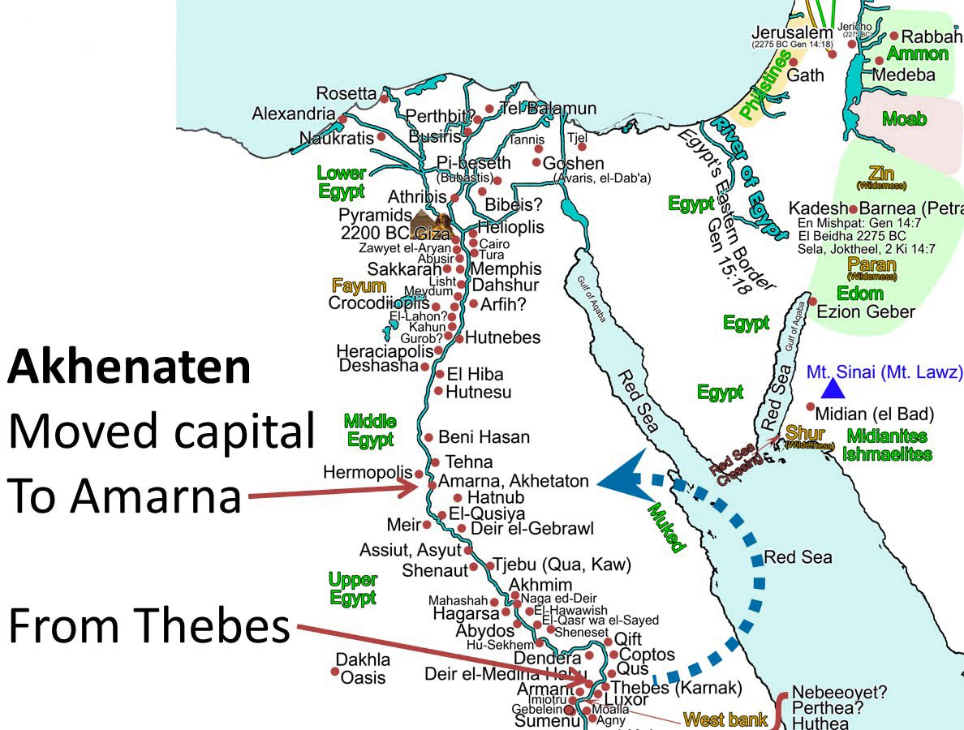
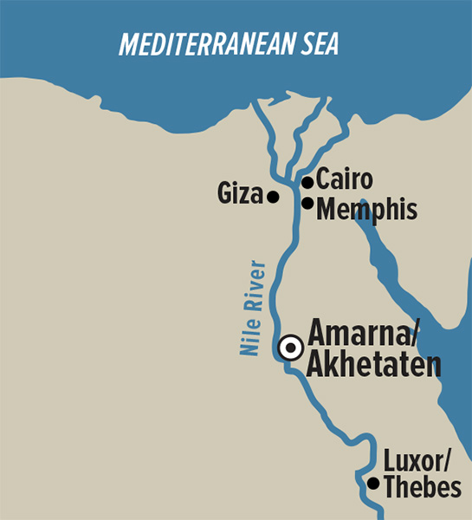

Slide 7
Overview:
WHY:
Religious Motivation: Dedicated to the worship of Aten.
Political Strategy: Move away from the influence of Amun priesthood.
Symbolic Break: Represent a new beginning for Egypt.
Chosen for its remote and uninhabited location.
Proximity to the Nile for resources and transportation.
Surrounded by cliffs forming a natural boundary.
HOW:
To expedite construction, most buildings were made of mudbrick and then white-washed.
The city’s location, resembling the hieroglyph for “horizon,” may have influenced its choice.
Akhenaten described it as the Aten’s “seat of the First Occasion.”

Slide 8
ACTIVITY - Layout of Akhetaten
Read through the info sheet provided
Highlight key words
Cut and stick into your book

Slide 9
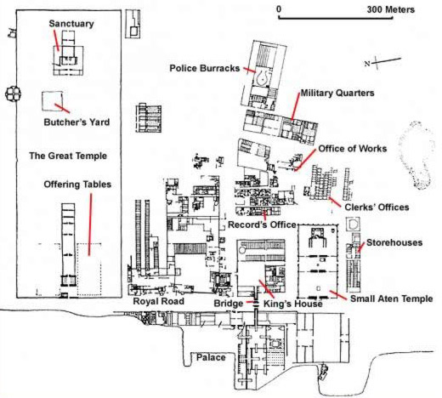

Slide 10
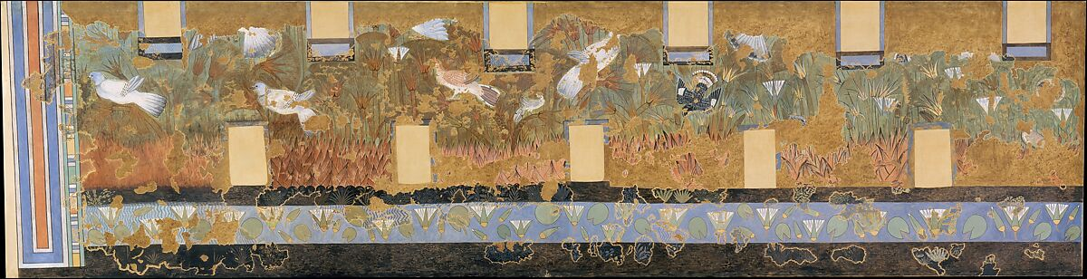
Evidence
Painting from the 'Green Room' in the North Palace at Amarna c. 1353–1336 BCE

Slide 11
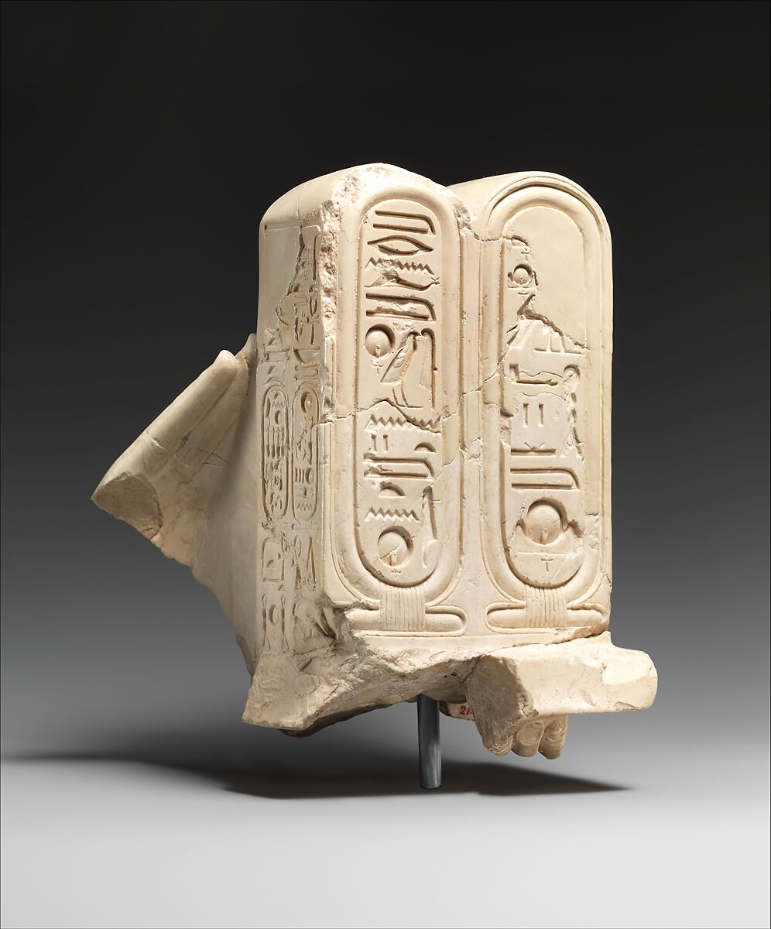
Evidence
Hands offering Aten cartouches (upper part of cartouches are a cast of British Museum EA 58471)
c. 1352–1336 BCE

Slide 12
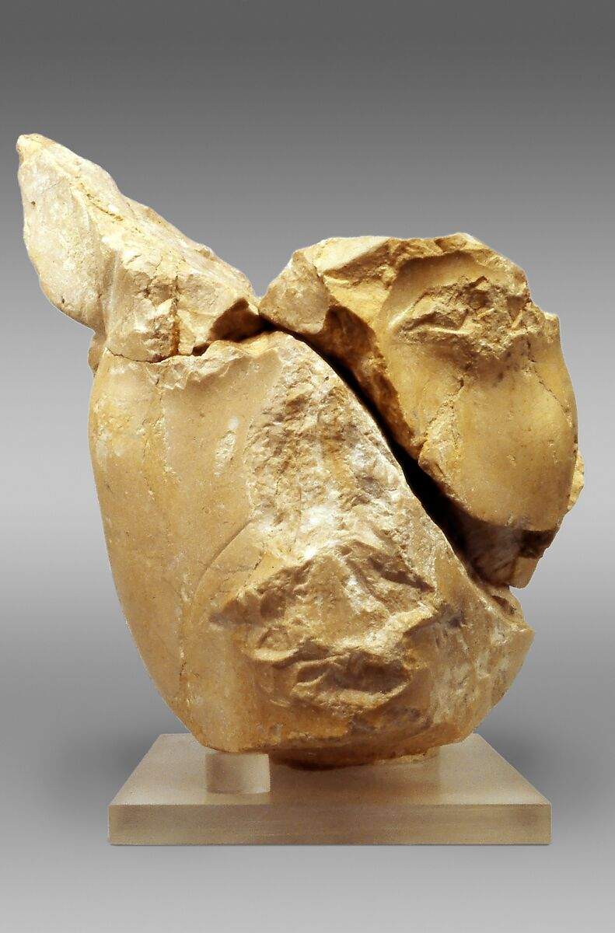
Evidence
Head of Akhenaten Wearing the Blue Crown, traces of a hieroglyph behind the neck
C. 1353–1336 BCE
Notes:
Explore
The blue crown, also known as the khepresh, was an ancient Egyptian royal headdress. It held significance both in battle and during ceremonies. Pharaoh Akhenaten, during his rule, wore this distinctive crown, which featured a cartouche inscribed with his name along the edge¹². The blue color symbolized power and divinity, emphasizing Akhenaten’s unique religious beliefs. 🌟👑

Slide 13
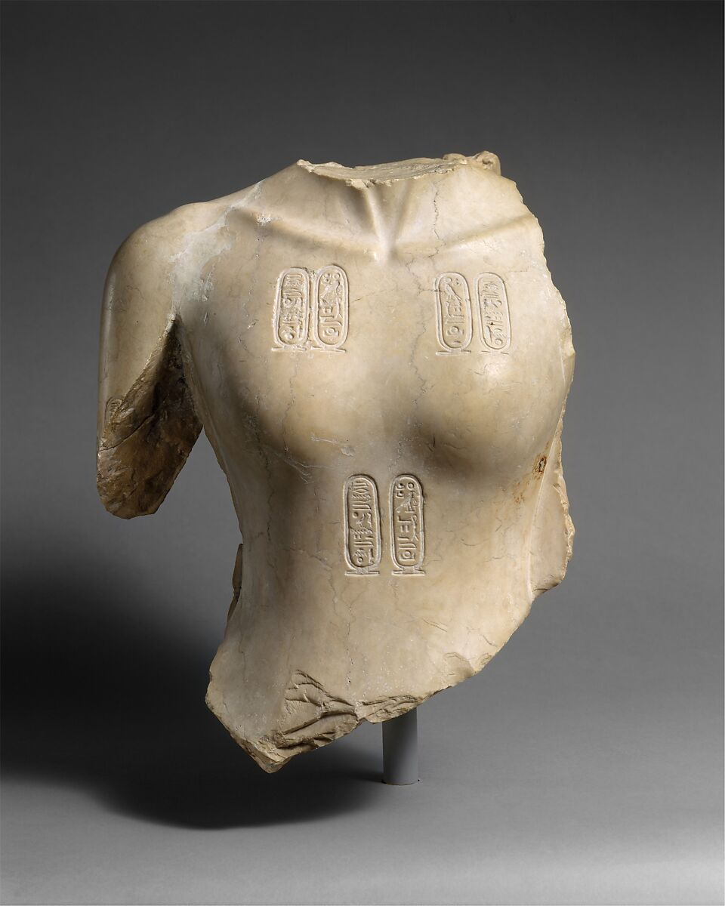
Evidence
Torso of Akhenaten
c. 1353–1336 BCE

Slide 14
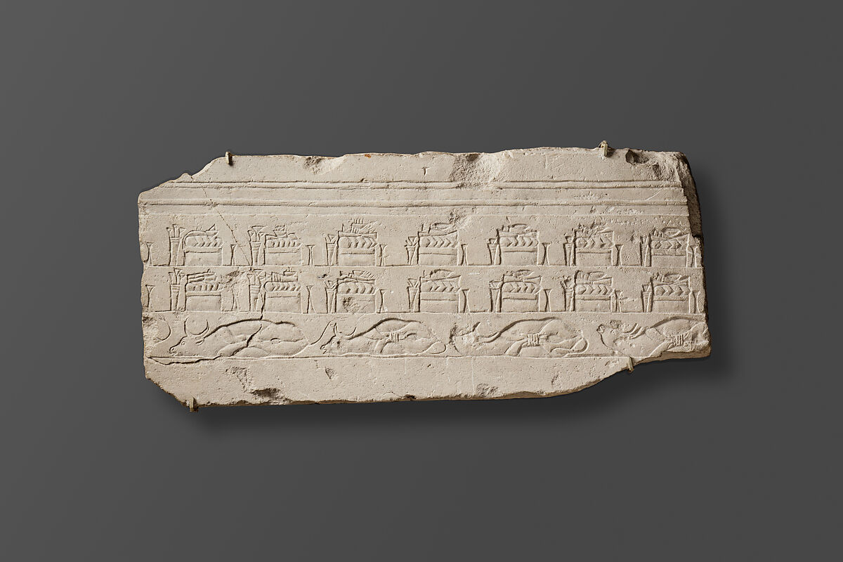
Evidence
Talatat with Offerings in the Temple
c. 1353–1336 BCE
Notes:
Explore
A talatat is a limestone block of standardized size (approximately 27 by 27 by 54 cm, corresponding to 1/2 by 1/2 by 1 ancient Egyptian cubits). These blocks were used during the 18th Dynasty reign of Pharaoh Akhenaten in constructing the Aton temples at Karnak and Akhetaten (modern Amarna). Their uniform size and lightweight nature made construction more efficient. The term “talatat” likely derives from the Arabic word for “three,” indicating that each block is three hand-spans long¹². After Akhenaten’s death, the temples were dismantled, and the talatat were reused in other constructions³. Thousands of these blocks have been recovered, and ongoing efforts, such as the Akhenaten Temple Project, aim to reconstruct the original temple architecture and decoration using these fragments⁴. 🏛️🌟

Slide 15
ACTIVITY – Design your own city
INSTRUCTIONS
Form a pair or group of 3
Discuss the essential areas for your city (religious, administrative, residential).
Use maps and drawing materials to design a basic city layout.
Present your city layout and explain your design choices.
EXAMPLE

